Slide 1


Common LISP
AN INTRODUCTION

Slide 2

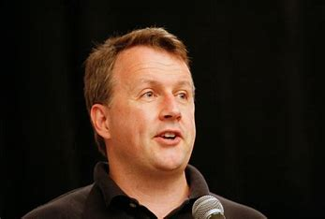

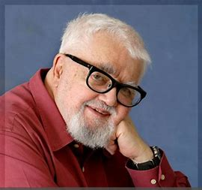


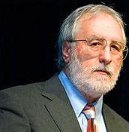

Introduction
- What’s the common lisp(CL).
-One of the most powerful languages in the field of artificial intelligence.

Slide 3
history
Year
house
people
First one compiled in “American national Standards Institute & International Organization Standardization” in 1984.
There is no official home for it.
John McCarthy.
Guy L. Steele Jr.
Richard P. Gabriel .
Kent Pitman .
Paul Graham.
Environment
- Portacle.
-REPL .
-Emacs.
-Integrated Development Environments.
-Web Development.

Slide 4

Domain and Category
Artificial intelligence
Scientific computing
Database management
Web development

Slide 5

Goals and concerns
Flexibility
Portability
Efficiency

Slide 6
Contribution
Dynamic programming
Object oriented programming
Functional programming

Slide 7
What is unique or new in the common lisp?
24 unique built-in function.
A new 3D graphics project Kons-9.
development of SBCL.​
​
Common Lisp HyperSpec .
- Community activity.

Slide 8
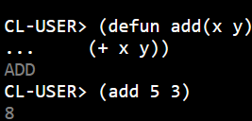
Overview
Simple example
Language type
Developed for who
Key features
What are macros?

Slide 9
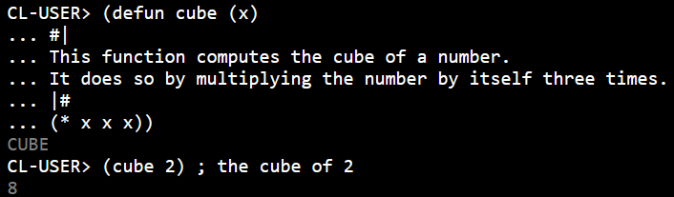
Comments in common lisp
Line Comments
Block Comments

Slide 10

Major commands
defun
let
if
cond
case
loop
setf
setq
format
read
write

Slide 11
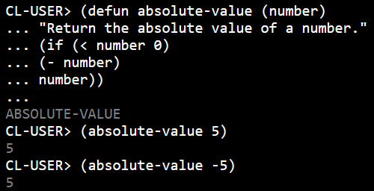
Example on the if function

Slide 12
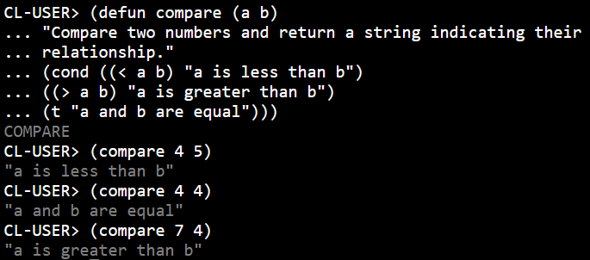
Example on the cond function

Slide 13
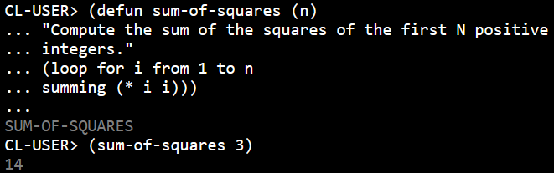
Example on the loop function

Slide 14

Pros
Evaluation of common lisp
cons
Expressive syntax
Dynamic programming
Powerful standard library
Extensibility
CLOS
Complexity
Performance
Tooling and ecosystem

Slide 15

Thank You

